Slide 1
EMBEDDED SYSTEM

Slide 2
WHAT IS EMBEDDED SYSTEM
An embedded system is a combination of hardware and software designed for a specific function.

Slide 3
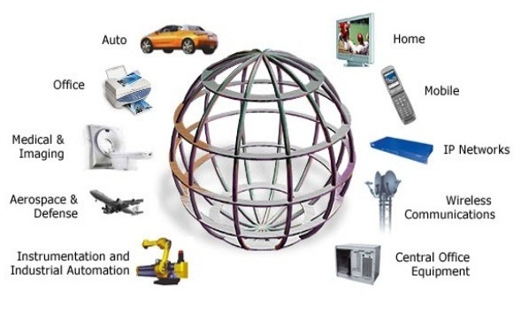
Embedded System Application

Slide 4
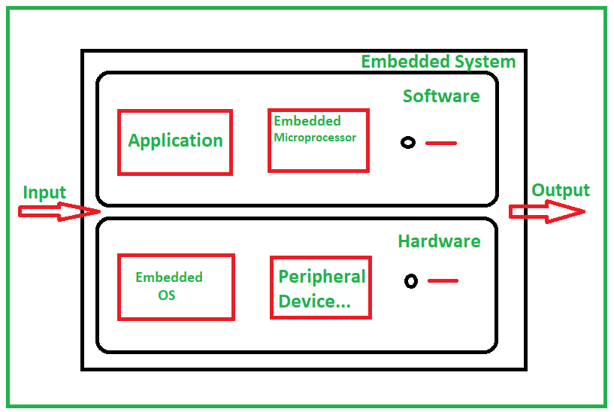
Architecture of an Embedded System

Slide 5
Component of Embedded system
Microcontroller/Microprocessor
Memory
Inputs Devices
Output Devices
Communication Interfaces
Power Supply
Timers and Counters
Analog-to-Digital Converters (ADC) and Digital-to-Analog Converters (DAC)
Software/Firmware

Slide 6
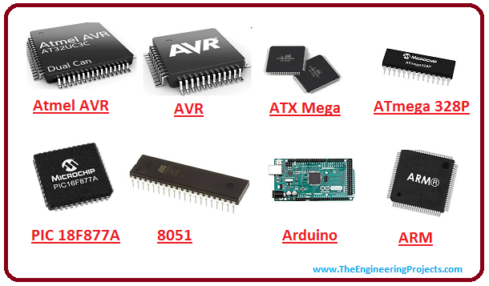
MICRO CONTROLLER

Slide 7
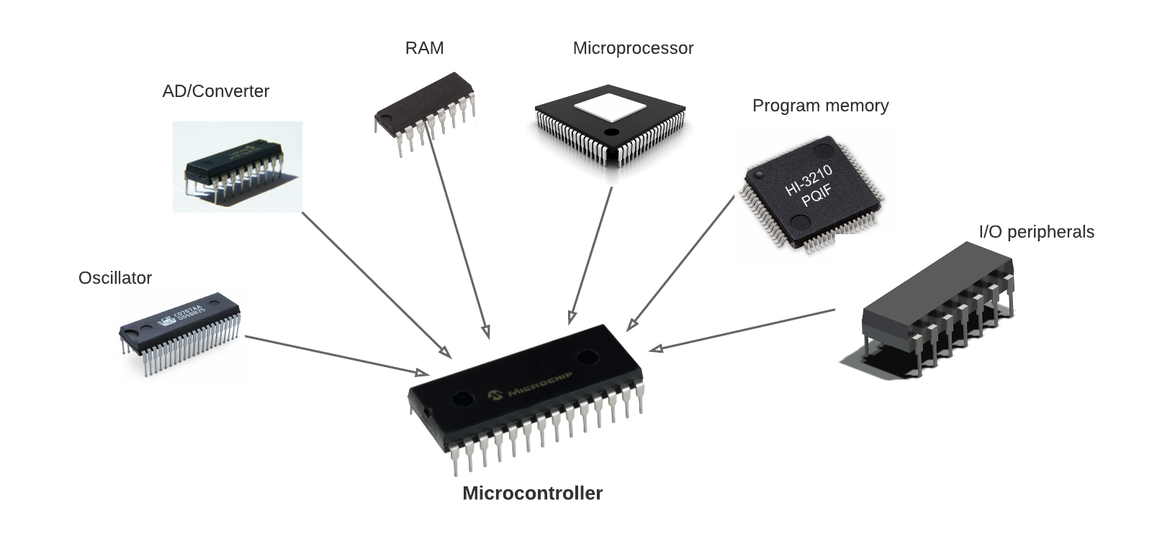

Slide 8
Example of Microcontroller Device
Vehicles
robots
office machines
medical devices
mobile radio transceivers
vending machines
home appliances

Slide 9
Microprocessor
It is a programmable device
performs some arithmetic and logical operations
Microprocessor is a digital device on a chip that can fetch instructions from memory, decode and execute them, and give results.

Slide 10
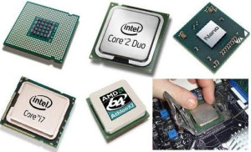
Examples

Slide 11
Examples of Microprocessor Devices
Televisions
VCRs, DVD players
ovens
stoves
clothes washers
home computers
alarm clocks
hand-held game devices

Slide 12
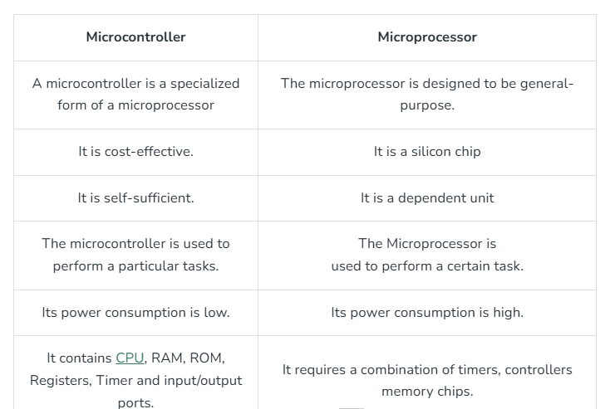
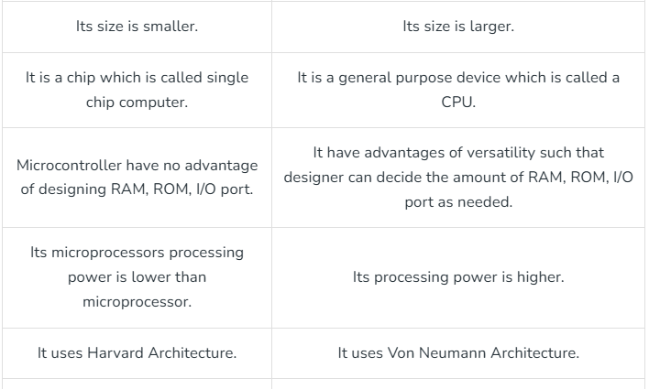
Difference Between Microcontroller and Microprocessor

Slide 13
Programs in Embedded System
C/C++
Assembly(low level, closer to hardware)
Sometime python(on high level boards like Raspberry pi)

Slide 14
Tools You’ll Use
Microcontroller(like arduino,pic,STM32)
IDE(like MPLAB X,STM32CubeIDE,Arduino IDE)
Programmer/Debugging (Used to upload and test code)
Breadboard and sensor (for building and testing circuits)

Slide 15
What is Embedded C
Embedded C is basically a version of the c programming language that is used to program microcontroller and other embedded devices

Slide 16
Thank you
Steffi arun
steffistanly@gmail.com

